Slide 1

Web Applications &
MongoDB Setup
Day 1: Understanding the Full Stack Journey & Environment Setup

Slide 2
Learning Goals
Mastering the fundamentals of MERN and Database Management

Slide 3






What You Will Learn Today
Web Architecture
MongoDB Mastery
Environment Setup
Understand how Clients, Servers, and Databases interact in a modern web ecosystem.
Setup MongoDB Atlas and use Compass for visual data exploration and management.
Install Node.js, VS Code, and launch your first React and Node projects.

Slide 4
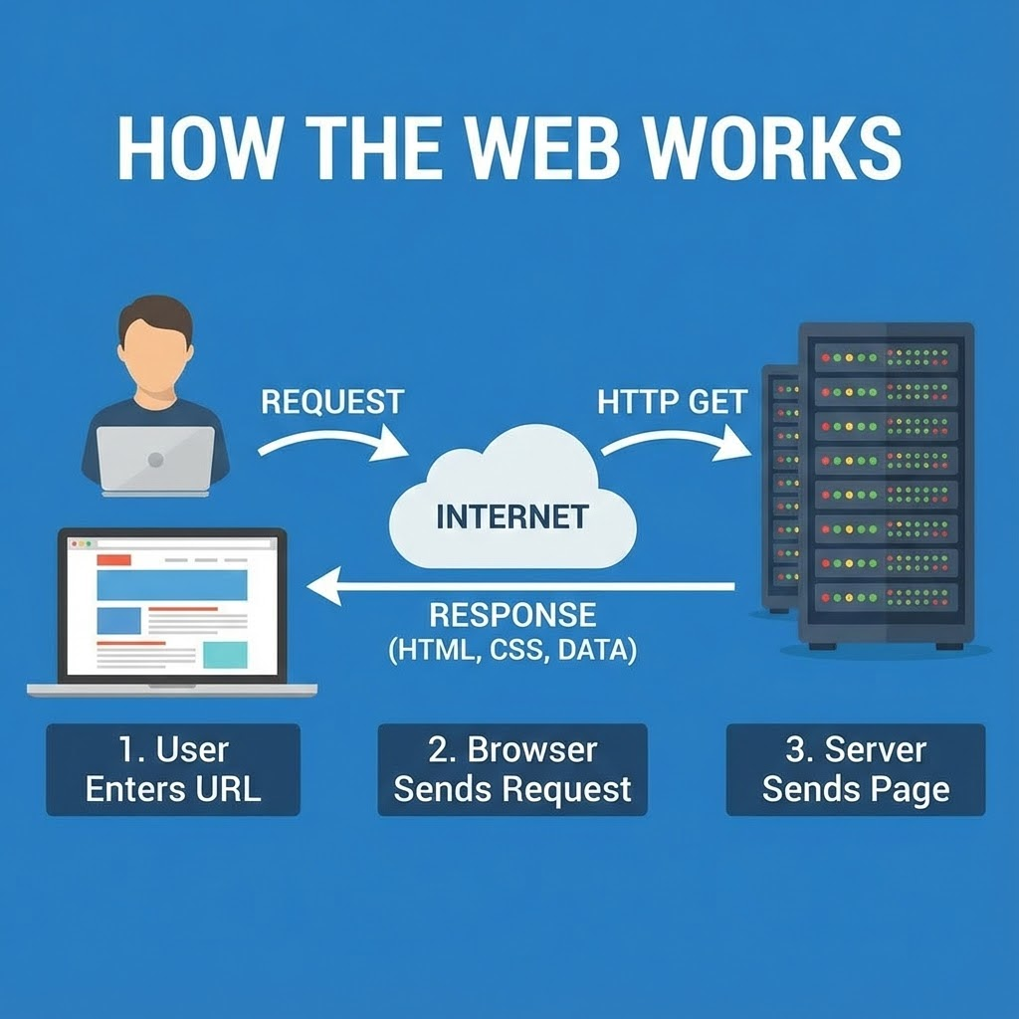

How the Web Works
Main Components
Client (Browser): Built with React (HTML/CSS/JS) to show UI.
Server: Handles logic and requests using Node.js & Express.
Database: Stores persistent data like users via MongoDB.

Slide 5
What is MERN Stack?
Tech | Name | Role in the Stack
M | MongoDB | NoSQL Database to store application data
E | Express.js | Backend web framework for Node.js
R | React | Frontend library for building User Interfaces
N | Node.js | JavaScript runtime for building scalable servers
Key Advantage: "JavaScript Everywhere" — One language for the entire stack.

Slide 6

MongoDB Atlas Setup
Sign up at mongodb.com/atlas using Google or Email.
Why Cloud?
Create a Free Shared Cluster (AWS Provider).
Set up a Database User with a secure username and password.
Atlas handles backups, scaling, and security automatically, letting you focus on code instead of server maintenance.
Whitelist your IP (use 0.0.0.0/0 for easy dev).

Slide 7
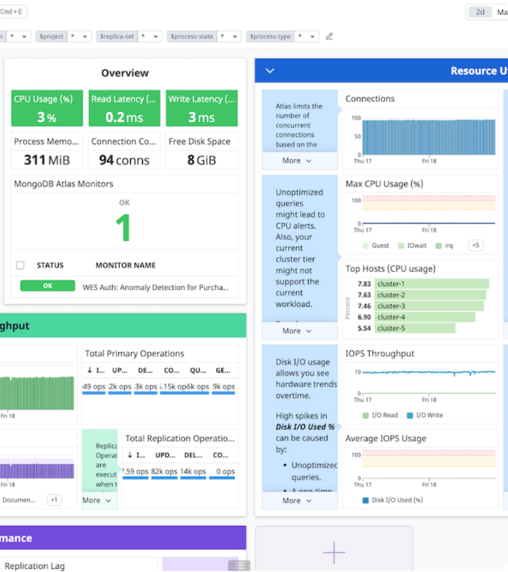
Atlas Dashboard
Clusters: Manage your database servers.
Collections: View and query your actual data.
Security: Manage users and network access.
The Atlas GUI provides a powerful overview of your database health and performance metrics in real-time.

Slide 8
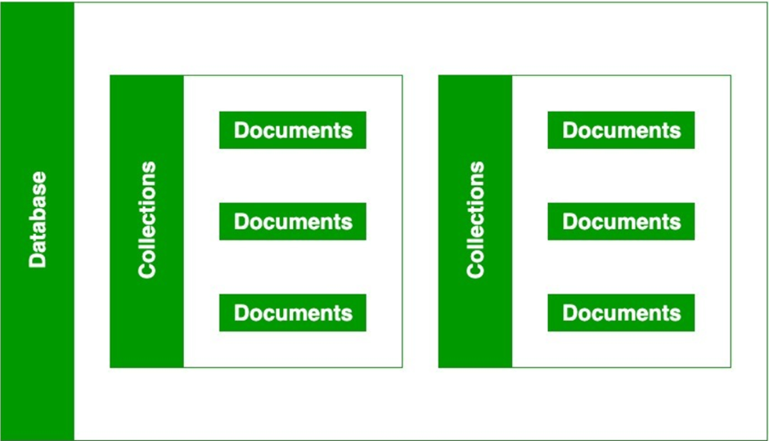

Databases & Collections
Data Hierarchy
MongoDB uses a flexible structure:
Database: Container for collections (e.g., mern_app).
Collection: Group of documents (e.g., users).
Document: Individual records stored in JSON-like format.

Slide 9

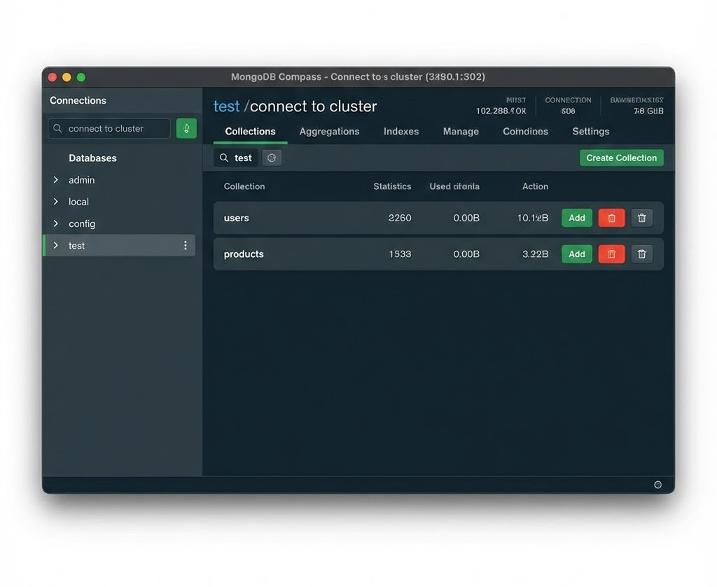
MongoDB Compass
Visual Data Handling
Compass is a GUI tool to manage your data locally without using the web dashboard.
Connect using your Atlas string.
Visual CRUD (Create, Read, Update, Delete).
Run complex filters and queries.
Analyze data schemas and performance.

Slide 10
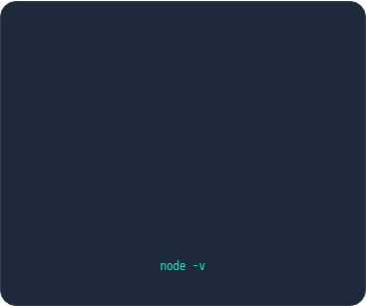





Installing Required Tools
Node.js
VS Code
Vite
Download from nodejs.org.
Check version:
The industry standard IDE. Install ES7+ React Snippets for speed.
Modern build tool for React projects. Fast and lightweight.

Slide 11
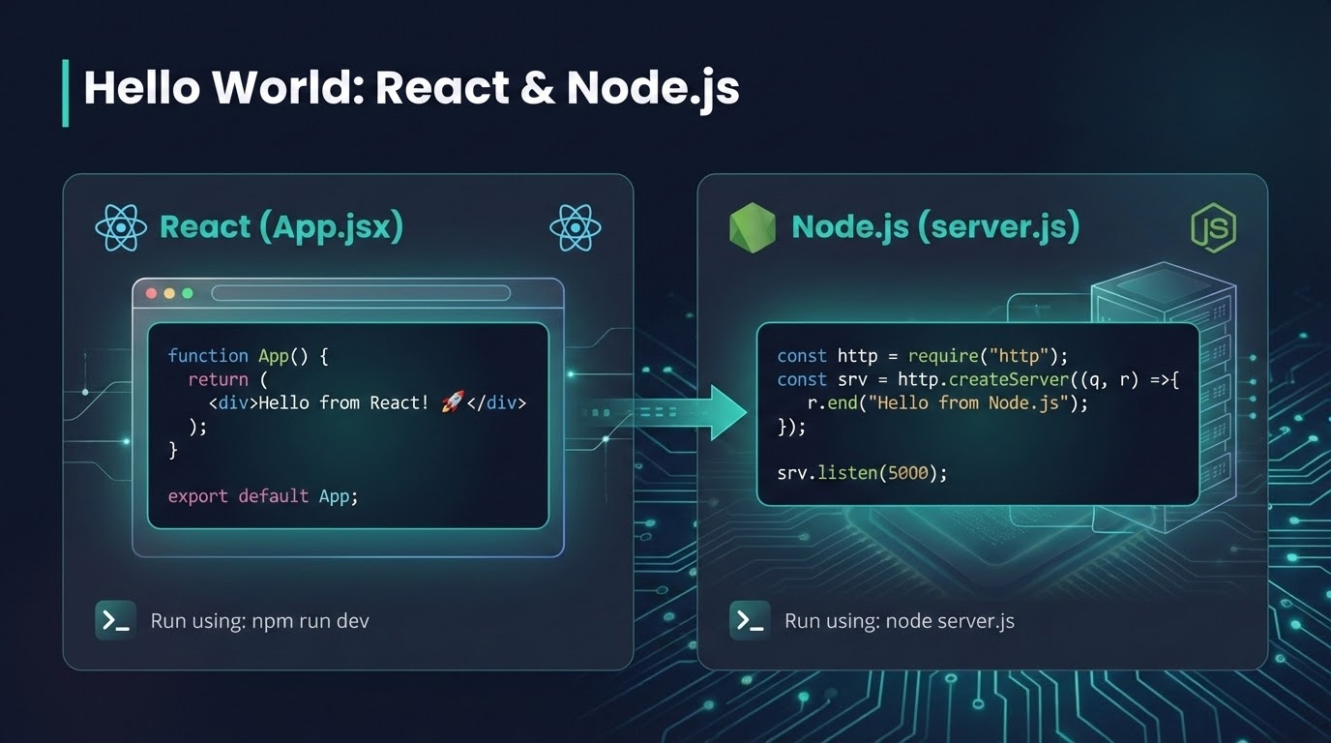



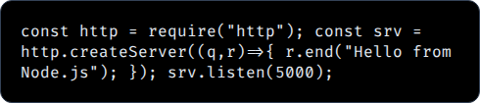
Hello World: React & Node.js
React (App.jsx)
Node.js (server.js)
Run using: npm run dev
Run using: node server.js

Slide 12
Questions?
Next: Diving deeper into React Components and Express Routing

